Slide 1
Graph-Based Reasoning over Heterogenous External Knowledge for Commonsense Question Answering
Shangwen Lv, Daya Guo, Jingjing Xu
AAAI-2020
汇报人：李伟
2020-12-27

Slide 2
Problem Definition
Given a question in our everyday life and several choices, we aim to select one choice that answers the question best.
Question: What do people typically do while playing guitar?
Choices: A. cry B. hear sounds C. singing D. anthritis E. making music

Slide 3
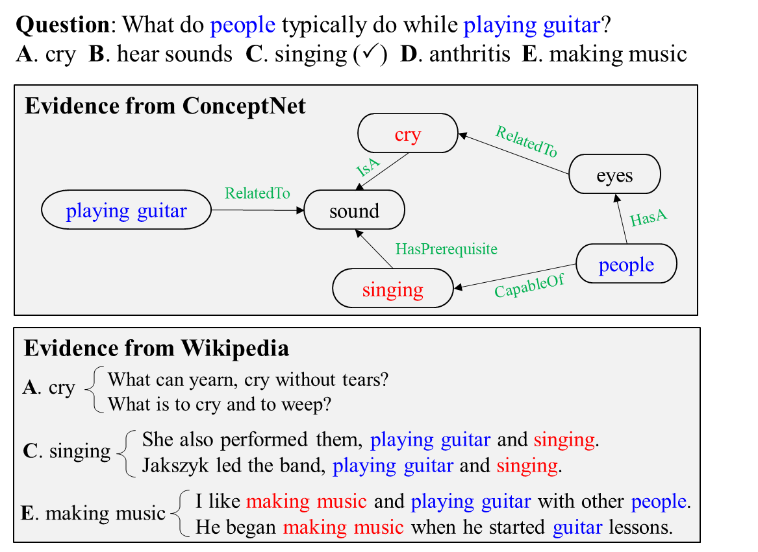
Motivation
Motivation
Heterogeneous knowledge sources are necessary for commonsense question answering
Utilize the structural and unstructured information of both sources
A、C
C
C、E

Slide 4
Contribution
• We introduce a graph-based approach to leverage evidence from heterogeneous knowledge sources for commonsense question answering.
• We propose a graph-based contextual representation learning module and a graph-based inference module to make better use of the graph information for commonsense question answering.
• Results show that our model achieves a new state-of-theart performance on the CommonsenseQA dataset.

Slide 5
Framework Overview
Knowledge Extraction
Extract knowledge from structured knowledge like ConceptNet and unstructured knowledge like Wikipedia.
Graph-Based Reasoning
Construct graphs for both knowledge and reason over the graphs to infer final answers.
Output
Graph-Based Reasoning
Knowledge Extraction
Question + Choice

Slide 6
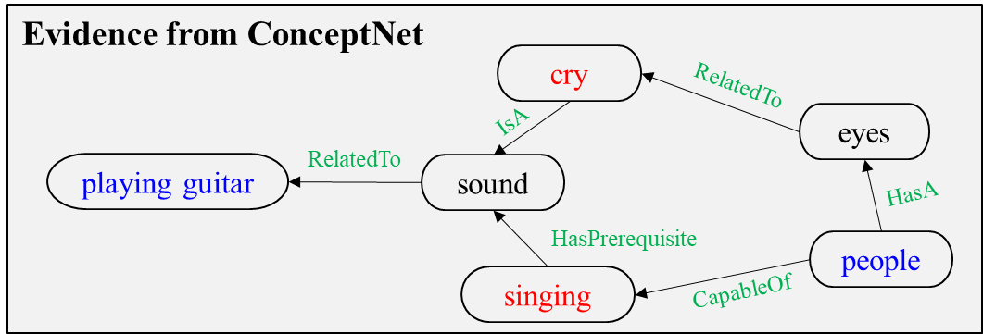
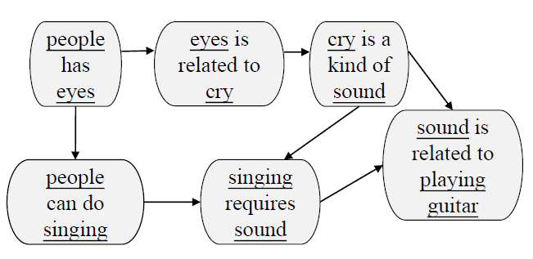
Knowledge Extraction
ConceptNet Evidence
Extract entities in question and choice, extract the paths from question entity and choice entity in ConceptNet (less than 3 hops).
Construct graphs to represent the evidence (Concept-Graph)
Each triple in ConceptNet is a node in the constructed graph and will be converted to natural language according to relation templates. If they two nodes have the same entity, there will be an edge between them. (We aim to utilize pre-trained models to get node representation)
ConceptNet
Concept-Graph

Slide 7
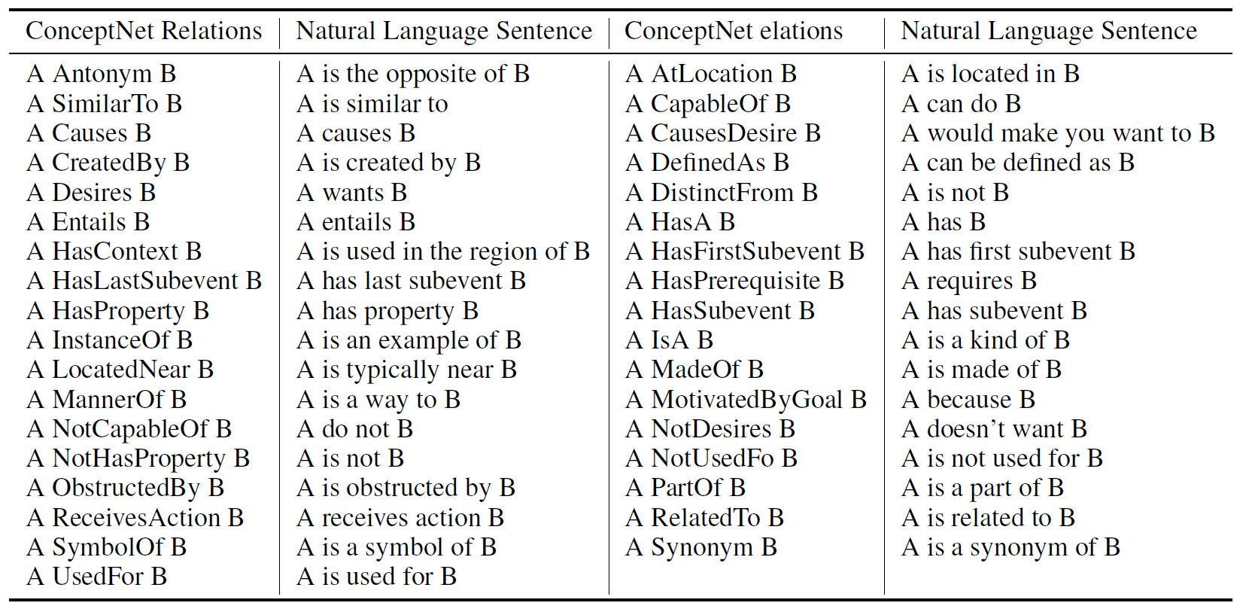
Knowledge Extraction
ConceptNet Relation Templates

Slide 8
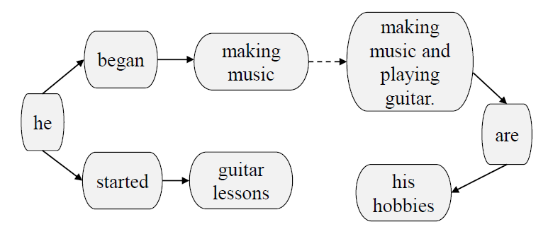
Knowledge Extraction
Wikipedia Evidence
Select top K sentences from the whole Wikipedia
Construct graphs to represent the structural information (Wiki-Graph)
Adopt Semantic Role Labeling (SRL) to extract predicates and arguments for each sentence. Predicates and arguments are nodes. The relations between predicates and arguments are the edges in the graph.
Node a is contained in node b and the number of words in a is more than 3.
Node a and node b only have one different word and the numbers of words in a and b are both more than 3
Making music and playing guitar are his hobbies.
He began making music when he started guitar lessons
Wikipedia evidence
Wiki-Graph

Slide 9
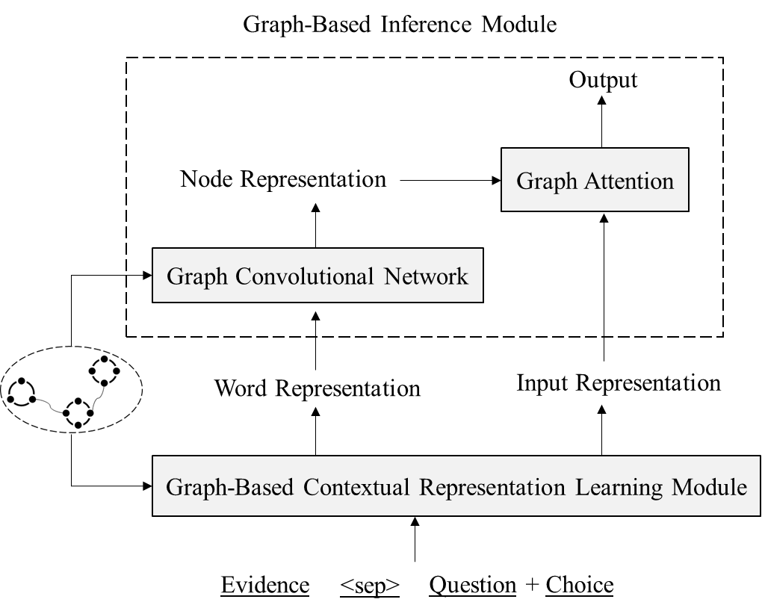
Graph-based Reasoning
Graph-based Contextual Representation Learning Module
Re-order the evidence sentences to re-define the distance between words.
Graph-based Inference Module
Utilize graph convolutional networks to obtain node representations
Adopt graph attention to aggregate nodes to infer final answers

Slide 10
Graph-based Contextual Representation Learning Module
Motivation
Evidence words with similar semantics should be put more closer.
Topology Sort
ConceptNet Evidence
Run topology sort algorithm on the constructed graph and re-order the evidence.
<“people has eyes”, “eyes is related to cry”, “people can do singing”, “cry is a kind of sound”, “singing requires sound”, “sound is related to playing guitar”>

Slide 11
Graph-based Contextual Representation Learning Module
Wikipedia Evidence
Construct a sentence-level graph according to Wiki-Graph.
For sentence A and B, two nodes $n_{i}∈A,n_{j}∈B,$ if there is an edge < $n_{i}$, $n_{j}$> in Wiki-Graph, there will be an edge <A,B> in the sentence graph.
Run topology sort algorithm on the sentence-level graph.
Making music and playing guitar are his hobbies.
He began making music when he started guitar lessons

Slide 12
Graph-based Contextual Representation Learning Module
Word Representation
Input Representation<cls>
Pre-trained Language Model ( BERT, XLNet, RoBERTa)
Reordered ConceptNet Evidence
<sep>
Reordered Wikipedia Evidence
Question + Choice
<sep>

Slide 13
Graph-based Inference Module
Adopt Graph Convolutional Network to learn node representations for Concept-Graph and Wiki-Graph.
Node representation is initialized with the average of token embeddings from XLNet.
Graph attention between Input Repretation<cls> and graph nodes to aggregate graph information for inferences.

Slide 14
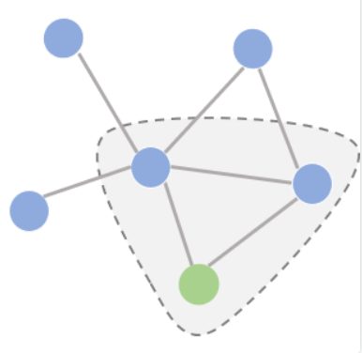
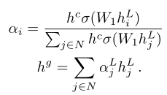
Graph-based Inference Module

Slide 15
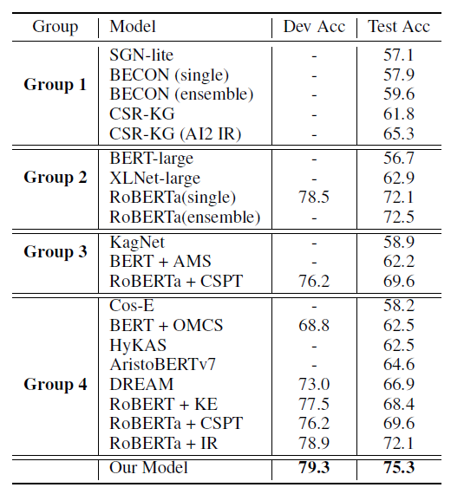
Experiments
Datasets
CommonsenseQA: (9,741/1,221/1,140)
Pre-trained Model: XLNet
Group 1: No description
Group 2: Pre-trained language model
Group 3: Pre-trained model + structural knowledge
Group 4: Pre-trained model + unstructured knowledge

Slide 16
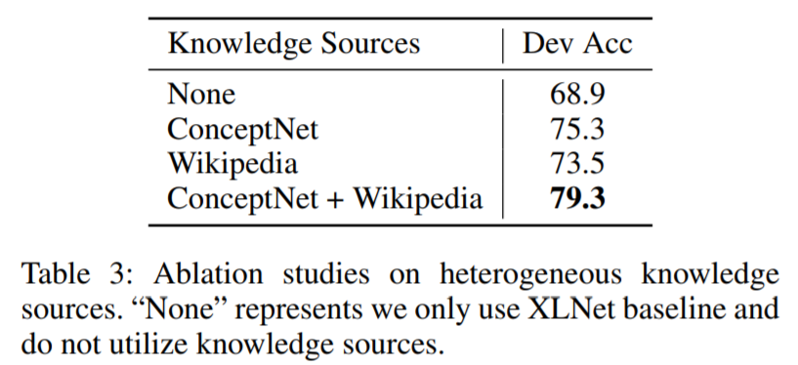
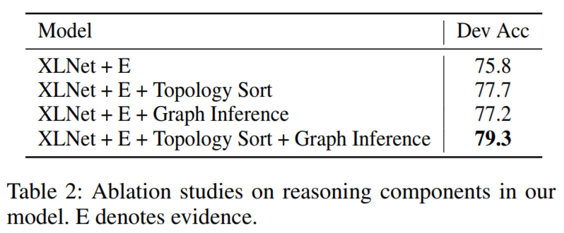
Ablation Study
Ablation Study on Knowledge Sources
Ablation Study on Reasoning Modules

Slide 17
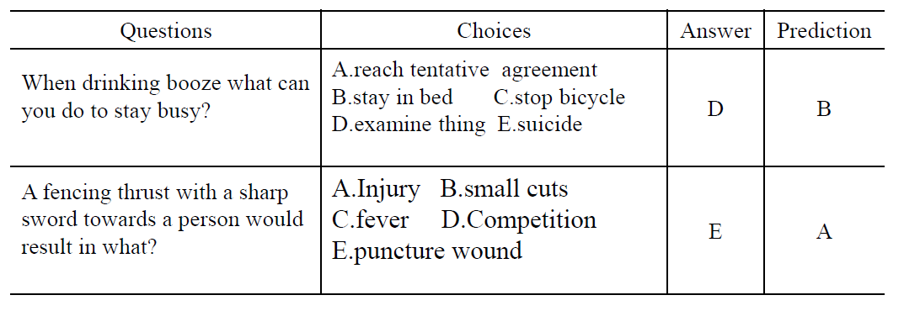
Error Analysis
We conduct error analysis on 50 error cases in the dev set
Lack of evidence (10)
Enough evidence but too similar to distinguish (38)
Dataset noise, 2 choices are the same (2)

Slide 18
Thank you！

